Slide 1
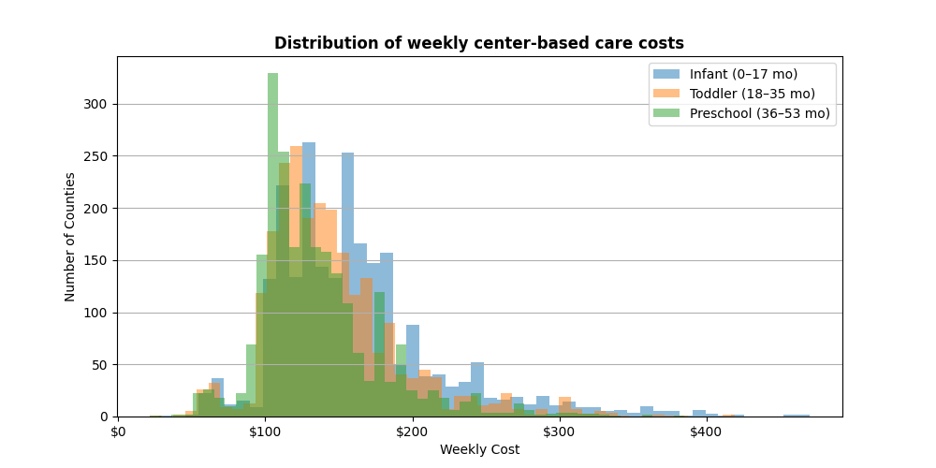
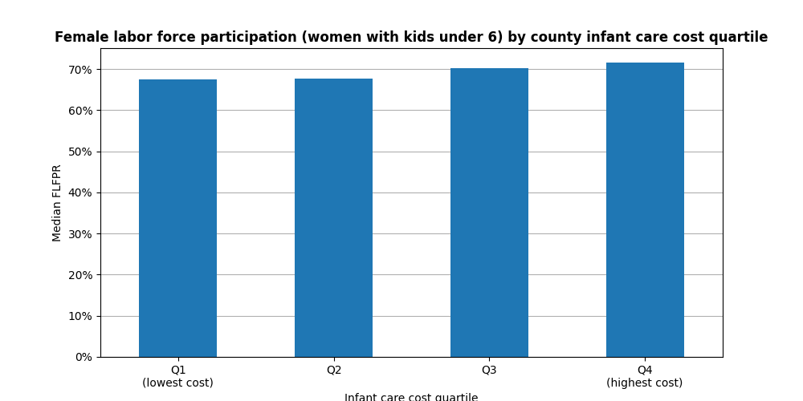
The Hidden Tax on Working Families:
What Childcare Really Costs
Most US counties report weekly infant care costs between $100 - $175, reflecting the modal experience for most working families.
Infant costs (blue) are right-shifted relative to toddler and preschool, confirming that younger children cost more in nearly every market.
The long right tail extends beyond $400/week - driven by high-cost urban metros like New York City, San Francisco, and Boston.
Employers should offer childcare subsidies as a workforce benefit.
Legislators should expand subsidy eligibility.
Researchers should use NDCP data to target the most burdened counties.
The majority of US counties report:
Median FLFPR rises slightly from Q1 (67%) to Q4 (72%), the highest cost counties have marginally higher female workforce participation
High-cost counties are predominantly urban with higher wages. Women in these areas can afford care and earn enough to make working worthwhile.
The burden falls hardest on moderate-income families caught between high costs and insufficient earnings.
Source: U.S. Dept. of Labor Women's Bureau - National Database of Childcare Prices (2008–2018)

